Slide 1
Module-3
3.3. Concept of classification rules, Separate and conquer method, The One Rule algorithm, Rules from decision trees

Slide 2
Concept of Classification Rules
Classification rules represent knowledge in the form of logical if-else statements that assign a class to unlabeled examples.
They are specified in terms of an antecedent and a consequent; these form a hypothesis stating that "if this happens, then that happens.“
The antecedent comprises certain combinations of feature values, while the consequent specifies the class value to assign if the rule's conditions are met.
Example Antecedent
if aerial = “yes” then
return class = “bird” Consequent
else
return class = “mammal”
end if

Slide 3
Separate and Conquer Method
Classification rule learning algorithms utilize a heuristic known as separate and conquer.
The process involves identifying a rule that covers a subset of examples in the training data, and then separating this partition from the remaining data.
As rules are added, additional subsets of data are separated until the entire dataset has been covered and no more examples remain.

Slide 4
One Rule Algorithm(1R Algorithm)
The way this algorithm works is simple. For each feature, 1R divides the data into groups based on similar values of the feature.
Then, for each segment, the algorithm predicts the majority class.
The error rate for the rule based on each feature is calculated, and the rule with the fewest errors is chosen as the one rule.
Example
For the Travels By feature, the data was divided into three groups: Air, Land, and Sea. Animals in the Air and Sea groups were predicted to be non-mammal, while animals in the Land group were predicted to be mammals. This resulted in two errors: bats and frogs. The Has Fur feature divided animals into two groups. Those with fur were predicted to be mammals, while those without were not. Three errors were counted: pigs, elephants, and rhinos. As the Travels By feature resulted in fewer errors, the 1R algorithm would return the following "one rule" based on Travels By:
  If the animal travels by air, it is not a mammal
  If the animal travels by land, it is a mammal
  If the animal travels by sea, it is not a mammal
The algorithm stops here, having found the single most important rule.

Slide 5
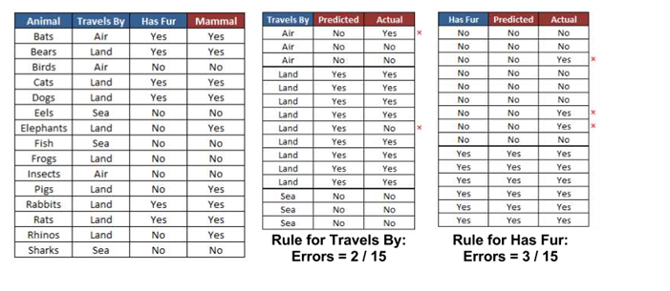
Example

Slide 6
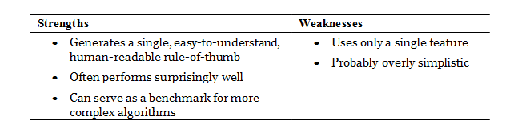

Slide 7
Rules from decision trees
Classification rules can also be obtained directly from decision trees.
Beginning at a leaf node and following the branches back to the root, you will have obtained a series of decisions.
These can be combined into a single rule.

Slide 8
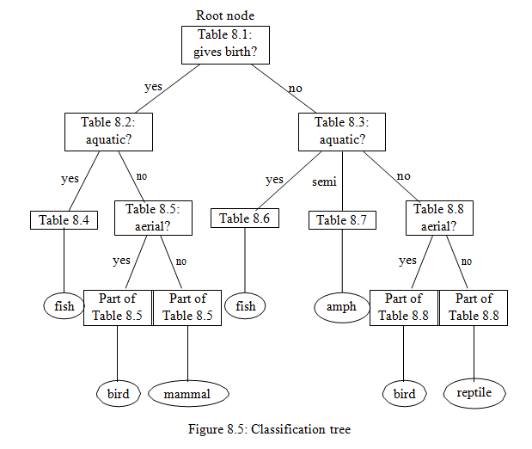
Example

Slide 9
Algorithm for classification of vertebrates

Slide 10


